Slide 1
What’s More Scary?
Go to the side of the room the picture is on for your answer

Slide 2
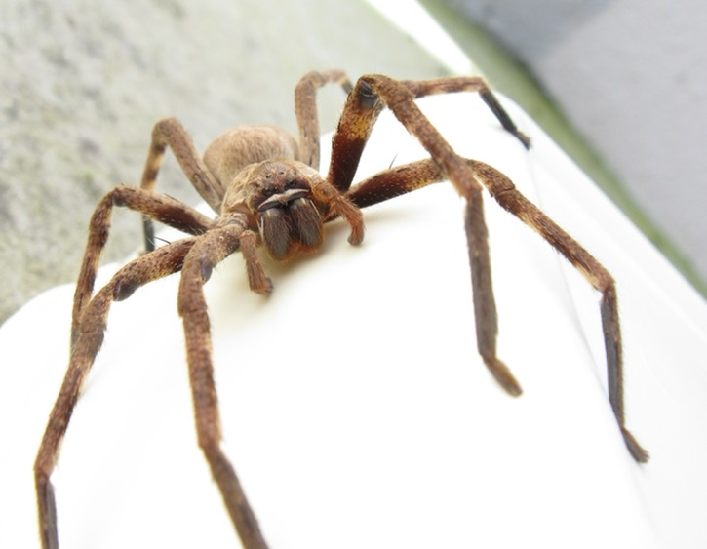
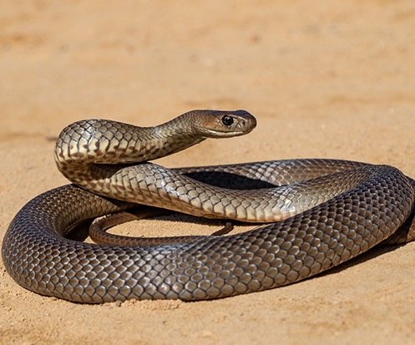
OR
SPIDERS
SNAKES

Slide 3
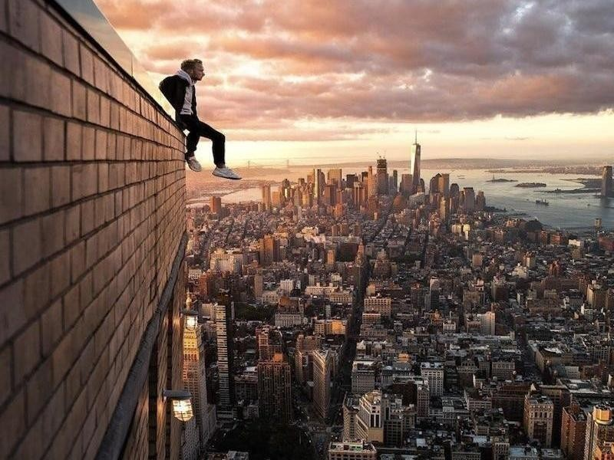
OR
HEIGHTS
GERMS

Slide 4
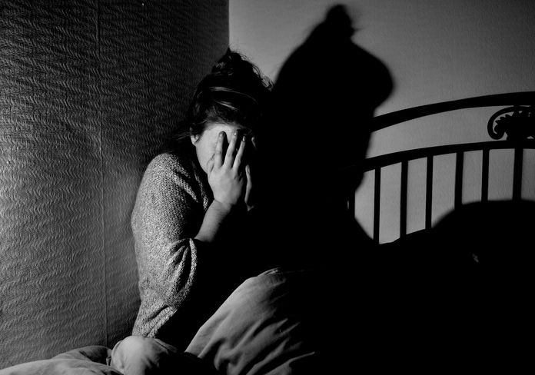
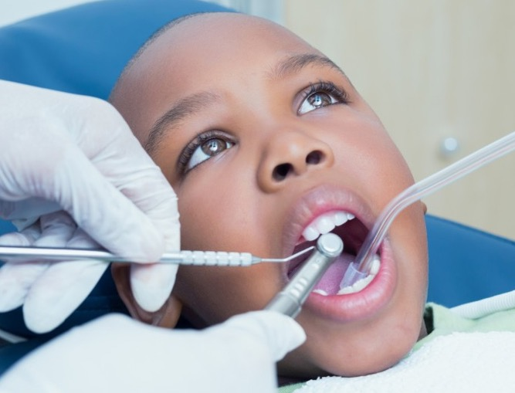
OR
DARK
DENTIST

Slide 5
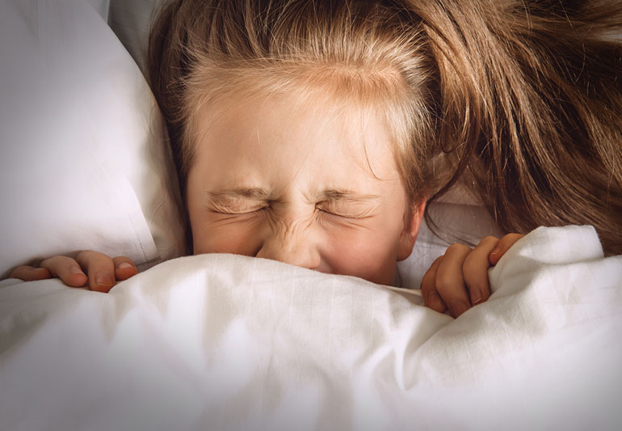
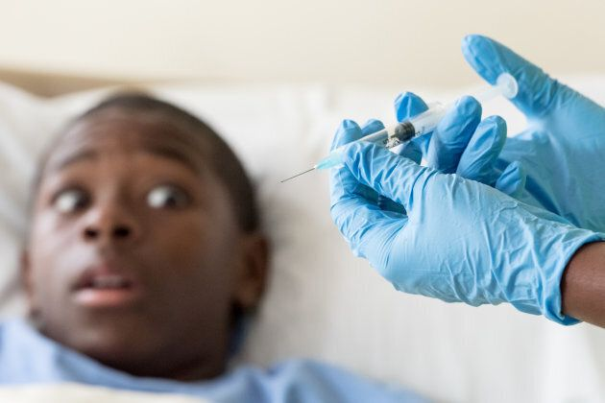
OR
NIGHTMARES
NEEDLES

Slide 6
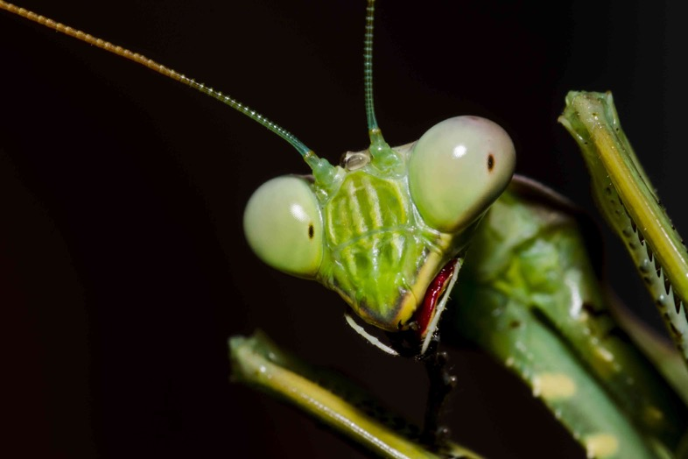
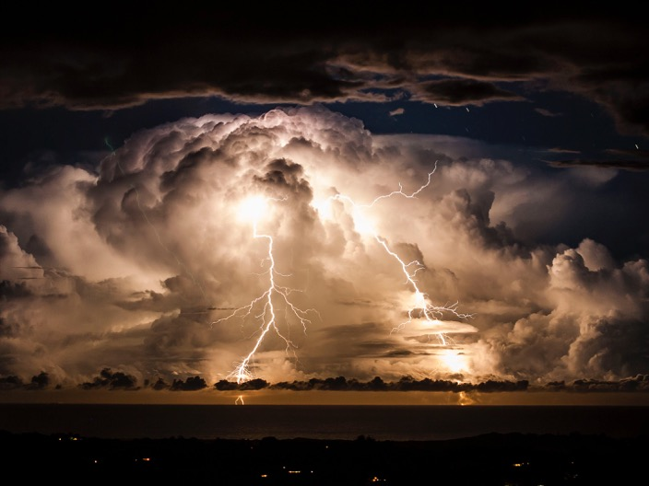
OR
BUGS
STORMS

Slide 7
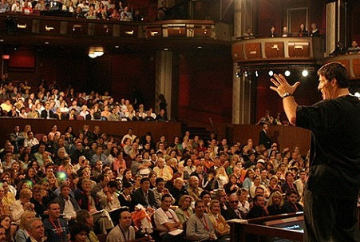
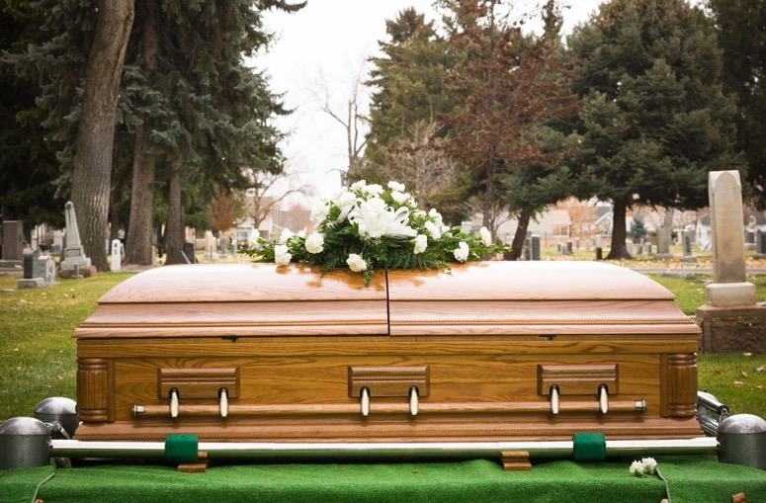
OR
SPEAKING TO A BIG CROWD
DEATH

